Slide 1
SCC211 Operation System
(Spinlocks & Monitors)
Zhang Jinyu – zjy@bjtu.edu.cn
School of Computer and Information Technology
SD408

Slide 2

Objectives
一般锁：A工作，B睡觉，A完成后通知B，来回花销大：
自旋锁：A工作，B在门外一直等待，不是睡觉
Spin locks 
Problems and mitigation
Blocking vs spinning 
Advantages and drawbacks
Monitors
In the real world
A (light) introduction
优点：提高效率
缺点: 消耗资源
虚拟机

Slide 3
Spinlock
Each java object has an intrinsic lock
Object.wait();
Object.notify();
So far we have dealt with threads that wait until notified
(This is implicit using synchronized keyword)
An alternative is to keep the thread active, and continuously ‘spin’ attempting to acquire the lock
This is a spin lock
(Potentially) improves threading performance and CPU usage
不睡觉，一直等

Slide 4
An Attempted Spin Lock Implementation
Do nothing (spin)
lk == 0
Lock is free
lk == 1
Lock is taken
Competition on variable lk
P1 reads zero, drops out of while loop
void get_lock (int *lk)
{ while (*lk ==1);
*lk = 1; // Claim the lock }
void release_lock(int *lk) { *lk = 0; //Let someone else claim lock }
Context switch occurs before P1 sets lk to 1 (claim lock)
P2 is scheduled, runs through get_lock(), claims lock
Critical section is not accessed atomically
P1 resumes, also claims the lock!

Slide 5
Spin lock execution
*lk = 0;
Context Switch
while (*lk ==1);
Both threads read
*lk = 0
while (*lk ==1);
*lk = 1;
同时得到锁！
Both acquire the lock
*lk = 1;
return
return
Violates mutual exclusion (we have two threads with the same lock!)

Slide 6
Solution
Disable interrupts
系统中断
机器指令
软件方案
Special machine instruction ensuring atomicity
Software-only solution
java:使用同步语句
In Java would fix this by simply making get_lock() a critical section by using synchronize. Here we are trying to provide a lock with which synchronize might itself by implemented!

Slide 7
Disabling Interrupts
抢占式场景切换
Pre-emptive context switched only happens when interrupt occurs
Could disable interrupts to prevent context switch in critical section
程序执行过程中CPU会遇到一些特殊情况，是正在执行的程序被“中断”，cpu中止原来正在执行的程序，转到处理异常情况或特殊事件的程序去执行，结束后再返回到原被中止的程序处(断点)继续执行
进程切换需要中断
void get_lock()
{disable_interrupts();}
进入临界区，中断cpu
绑架cpu
void release_lock() {reenable_interrupts();}
在临界区开始位置设置标志，禁止进入
Or set flag at start of critical section and unset at end Interrupt Service Routine doesn’t call scheduler if it sees flag is set

Slide 8
While this works, comes with many disadvantages…
Interrupts might be disabled for a long time
Clock ticks, I/O events could be missed
There is only one lock for any and all critical sections
Interrupts will tend to be disabled frequently
Error proneness
Forgetting to call release_lock()

Slide 9
Slightly better disable-interrupts-based spin lock implementation
void get_lock (int *lk) {
try_again:
disable_interrupts();
if (*lk ==1); // Lock taken
{ reenable_interrupts(); //permit context switch
go to try_again; //spin }
*lk = 1; // Claim the lock
Reenable_interrupts(); }
void release_lock(int *lk) {
*lk = 0; //Let someone claim lock }
More fine grained We only disable interrupts while accessing small critical section that reads/updates lk variable
屏蔽中断
解锁
However all preceding disadvantages still apply

Slide 10
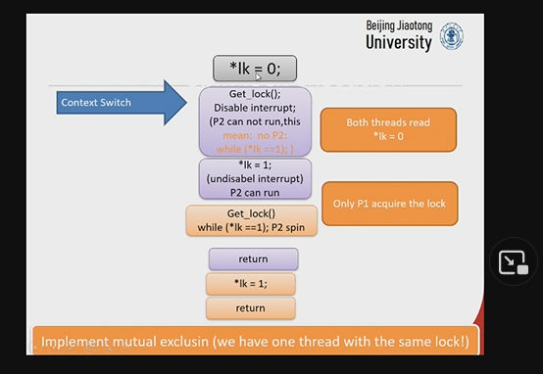

Slide 11
Machine Instruction
test-and-set, comp-and-swap, fetch-and-add
单机指令
检查变量值并原子性设置它
设置传递的变量为真，并告诉之前是真还是假
如果两个进程执行操作，都将target value设置为true，但只有一个返回false
Single machine instruction
Checks variable value and sets it atomically
Sets variable passed to true, and tells if was true or false before
If two processes perform operation, both set target value to true but only one returns false

Slide 12
Program
boolean test_and_set(boolean *target) {
boolean orig_val = *target;
*target = TRUE;
return orig_val; }
Performed atomically with hardware support – this is a software level example!

Slide 13
Machine Instruction: test_and_set() lock
void get_lock (int *lk) {
while(test_and_set(lk) == 1) ; // wait
}
void release_lock(int *lk) {
*lk = 0; //Let someone claim lock
}

Slide 14
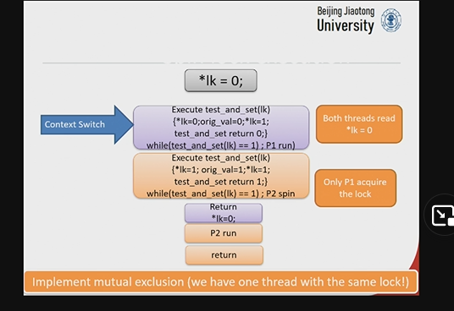
机器指令具有原子性，整个函数一次性执行完

Slide 15
Software Only – Peterson’s Algorithm
No special hardware needed
Simplified version that:
Only works with two threads (big limitation!)
Assumes thread ID are 0 and 1

Slide 16
Program
int tiebreak = 0; /* shared variable */
bool[] flag = {FALSE, FALSE}; /* shared variable */
void get_lock() {
int pid = thread_getid();
int other = 1 - pid;
flag[pid] = TRUE;
tiebreak = other;
while(flag[other] && tiebreak == other) ; /* spin */
}
void release_lock() {
flag[thread_getid()] = FALSE;
}
关键在于tiebreak，即轮到谁，tiebreak可以被多个线程修改，谁先修改谁先运行

Slide 17
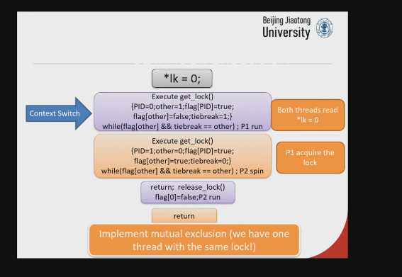

Slide 18
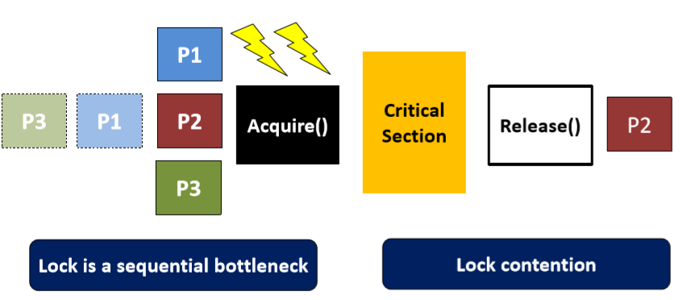
Spinlock Performance
Atomic read-alter-write instruction sequence supported by hardware
Instructions read a value from memory and write a new value atomically
顺序执行

Slide 19
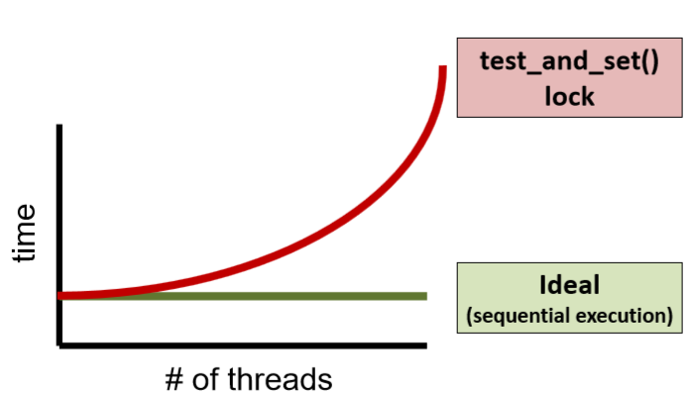
Hypothetical Performance
n threads attempting to access critical section
Increment shared variable 10 million times
How long should it take?
How long does it take?
涉及硬件，拖得慢
理论上顺序执行

Slide 20
Blocking vs spinning locks
考试题
Scheduler blocks threads while they wait
Good for long critical sections
Costly if lock accessed lots Frequent queue management
Blocking
一般锁
调度程序在线程等待时阻塞线程
适合长临界段
如果锁访问了很多，代价很高
频繁的队列管理
循环锁
围成一圈，直到拿到锁
适用于较短的临界段
长临界段的成本很高
避免队列管理
Sit in a tight loop until lock acquisition Good for short critical sections
Costly for long critical sections
Avoid queue management
Spinning

Slide 21
Monitor
监控
Concurrent control construct for synchronization and scheduling
Can perform mutual exclusion
Block for certain conditions to become true
Notify other threads that conditions are now true
You have been using this with the synchronized keyword in Java
同步调度并行控制结构
可以进行互斥
阻塞某些条件的实现
通知其他现在条件为真的线程

Slide 22
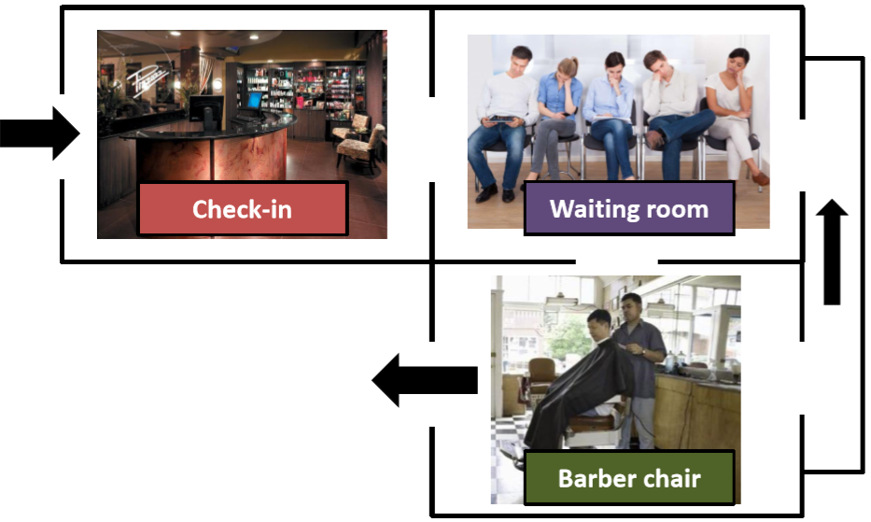
Monitors in the Real World

Slide 23
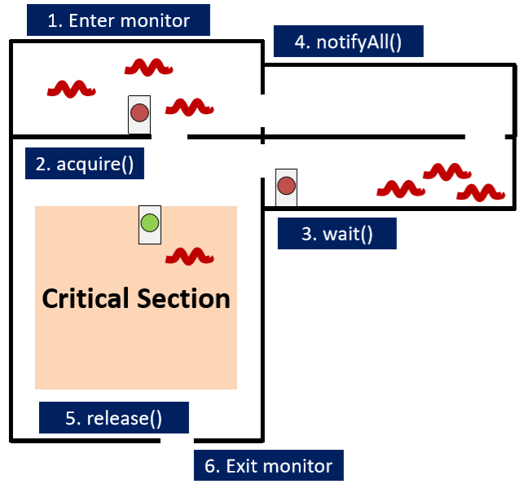
The ‘Monitor Room’
monitor相当于一个系统，管理整个流程
虚假唤醒

Slide 24
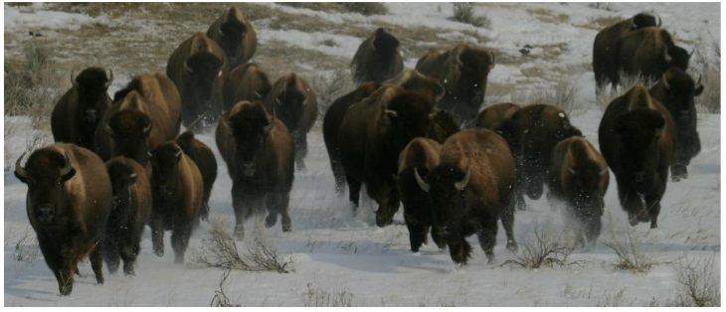
Thundering Herd Problem
Depends on shared resource
Semaphore CPU

Slide 25

Summary
Spin lock implementation
Interrupt  Hardware support (this is the most prevalent)
Software only
Blocking or spinning locks?
As always, depends on context
Can result in massive performance degradation
Number of threads and critical section duration
You’ll want to experiment within your own systems
Monitors
Concurrent control construct
More on this next lecture…
长/短临界区

Slide 26

Question？

